Slide 1

Content-aware Resizing of Images
Greg Merritt, Andrew Novicki, Jinyuan Zhao
for CS 585, Prof. Margrit Betke

Slide 2


Problem
Resizing of images
Resizing by resampling: leads to objects of interest losing focus to background.
Content-aware resizing: preserves visual coherence.
Goal: shrink or enlarge an image with content-aware resizing
Resized by resampling
Original
Content Aware Resizing (ideal)
Notes:
small changes to the input data can have large effects on the structure of the tree, due to the hierarchical nature of the tree-growing process, causing errors at the top to affect the rest of the tree.

Slide 3
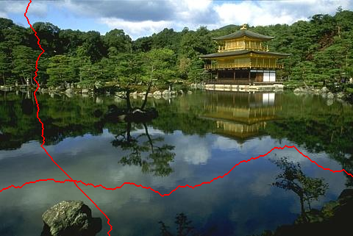
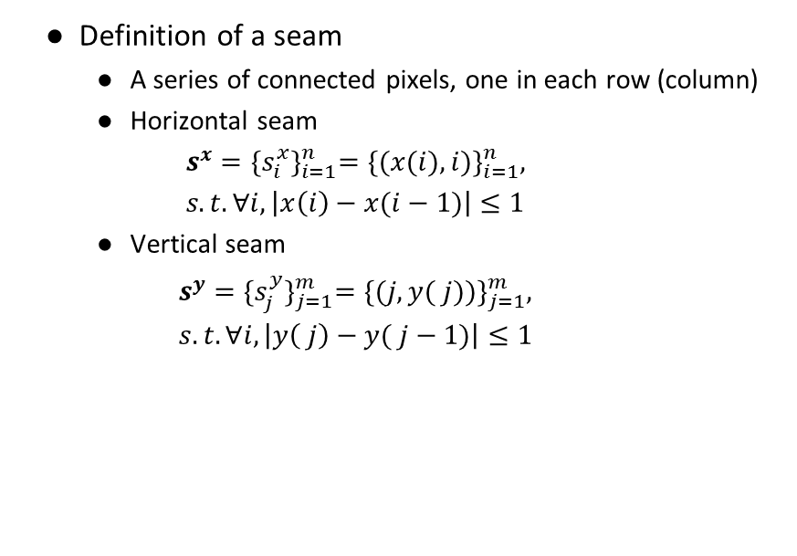
Seam Carving Method
Definition of a seam
A series of connected pixels, one in each row (column)
Horizontal seam
$$s^{x}={\{s_{i}^{x}\}}_{i=1}^{n}={\{(x(i),i)\}}_{i=1}^{n}, s.t. ∀i, \left|x\left(i\right)−x(i−1)\right|≤1$$
Vertical seam
$$s^{y}={\{s_{j}^{y}\}}_{j=1}^{m}={\{(j,y( j))\}}_{j=1}^{m}, s.t. ∀i, \left|y\left( j\right)−y( j−1)\right|≤1$$
Vertical seam
Horizontal seam
Notes:
small changes to the input data can have large effects on the structure of the tree, due to the hierarchical nature of the tree-growing process, causing errors at the top to affect the rest of the tree.

Slide 4
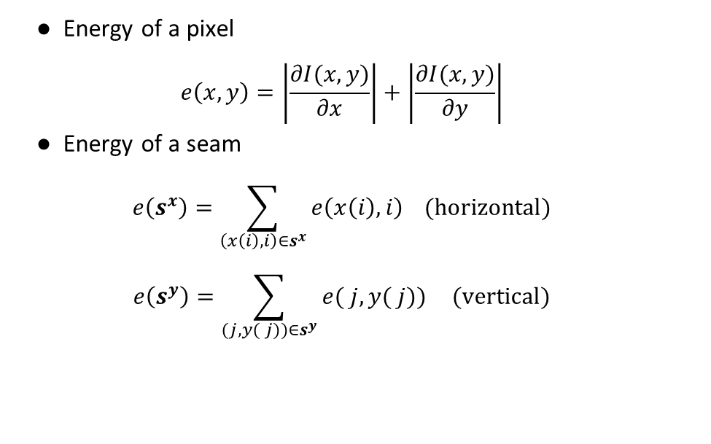
Seam Carving Method
Energy of a pixel
$$e\left(x,y\right)=\left|\frac{∂I(x,y)}{∂x}\right|+\left|\frac{∂I(x,y)}{∂y}\right|$$
Energy of a seam
$$e\left(s^{x}\right)=\sum_{\left(x\left(i\right),i\right)∈s^{x}}{e\left(x\left(i\right),i\right)} (horizontal)$$
$$e\left(s^{y}\right)=\sum_{(j,y( j))∈s^{y}}{e( j,y( j))} (vertical)$$
Original image
Energy map
Notes:
small changes to the input data can have large effects on the structure of the tree, due to the hierarchical nature of the tree-growing process, causing errors at the top to affect the rest of the tree.

Slide 5
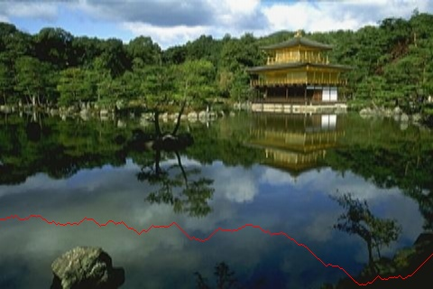
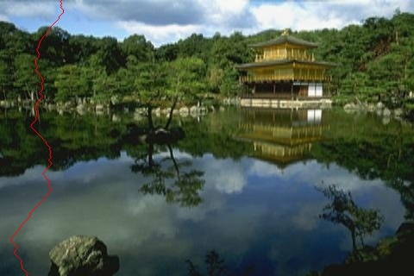
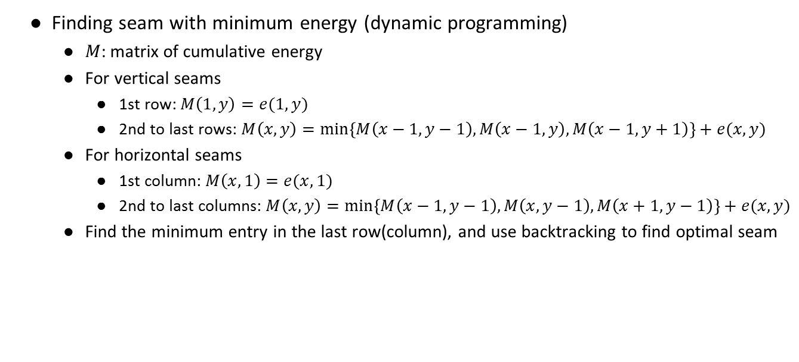
Seam Carving Method
Finding seam with minimum energy (dynamic programming)
$M$: matrix of cumulative energy
For vertical seams
1st row: $M\left(1,y\right)=e(1,y)$
2nd to last rows: $M\left(x,y\right)=\min\left\{M\left(x−1,y−1\right),M\left(x−1,y\right),M\left(x−1,y+1\right)\right\}+e(x,y)$
For horizontal seams
1st column: $M\left(x,1\right)=e(x,1)$
2nd to last columns: $M\left(x,y\right)=\min\left\{M\left(x−1,y−1\right),M\left(x,y−1\right),M\left(x+1,y−1\right)\right\}+e(x,y)$
Find the minimum entry in the last row(column), and use backtracking to find optimal seam
Optimal horizontal seam
Optimal vertical seam
Notes:
small changes to the input data can have large effects on the structure of the tree, due to the hierarchical nature of the tree-growing process, causing errors at the top to affect the rest of the tree.

Slide 6




Seam Carving Method
Algorithm for image shrinking
Calculate the number of rows (columns) to be removed: $N$
for $i$ from $1$ to $N$
Find the horizontal (vertical) seam with minimum energy
Delete all pixels in this seam
(3) Output resized image
Original image
Shrinking by resampling
Seam carving
Notes:
small changes to the input data can have large effects on the structure of the tree, due to the hierarchical nature of the tree-growing process, causing errors at the top to affect the rest of the tree.

Slide 7


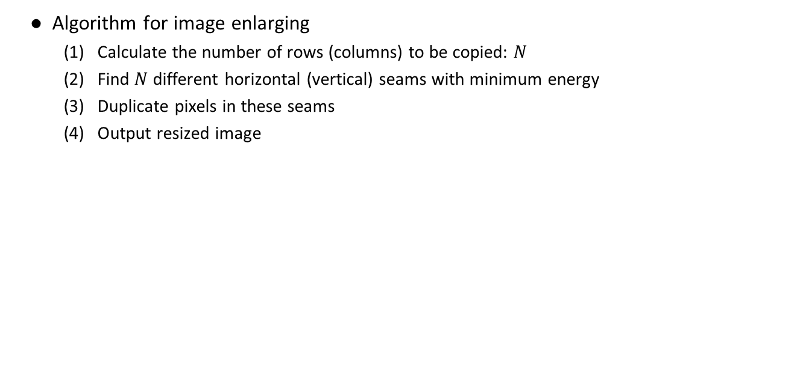
Seam Carving Method
Algorithm for image enlarging
Calculate the number of rows (columns) to be copied: $N$
Find $N$ different horizontal (vertical) seams with minimum energy
Duplicate pixels in these seams
Output resized image
Original image
Seams to be copied
Enlarged image
Notes:
small changes to the input data can have large effects on the structure of the tree, due to the hierarchical nature of the tree-growing process, causing errors at the top to affect the rest of the tree.

Slide 8


Seam Carving Method
Shrinking in one dimension and enlarging in the other dimension
Resizing by resampling
Original image
Resizing by seam carving
Notes:
small changes to the input data can have large effects on the structure of the tree, due to the hierarchical nature of the tree-growing process, causing errors at the top to affect the rest of the tree.

Slide 9
Other results
Image shrinking
Original
512x512
Output
400x400
Notes:
small changes to the input data can have large effects on the structure of the tree, due to the hierarchical nature of the tree-growing process, causing errors at the top to affect the rest of the tree.

Slide 10
Other results
Image enlarging
Original
512x512
Output
600x600
Notes:
small changes to the input data can have large effects on the structure of the tree, due to the hierarchical nature of the tree-growing process, causing errors at the top to affect the rest of the tree.

Slide 11


Other results
Many objects
Minimum Energy seams are difficult to identify
Main objects are distorted
Single object
Minimum Energy Seams are easy to identify
Main object keeps its shape
Notes:
small changes to the input data can have large effects on the structure of the tree, due to the hierarchical nature of the tree-growing process, causing errors at the top to affect the rest of the tree.

Slide 12

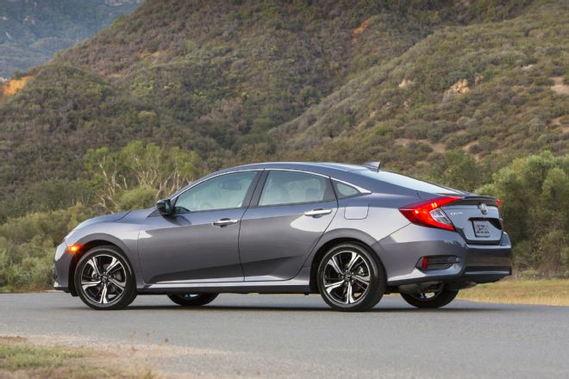

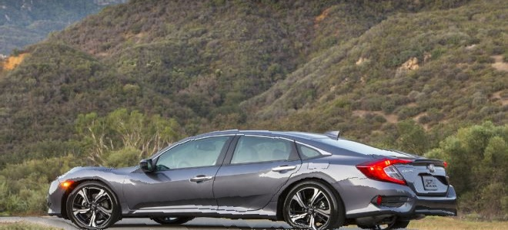
Other results
Simple background
Main object keeps its shape
Complicated background
Main object is distorted
Notes:
small changes to the input data can have large effects on the structure of the tree, due to the hierarchical nature of the tree-growing process, causing errors at the top to affect the rest of the tree.

Slide 13


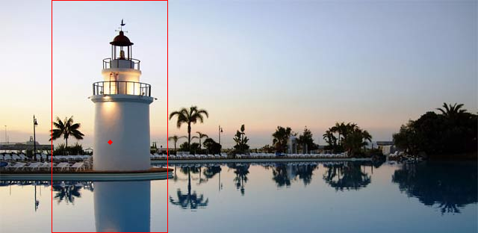
Histogram-Based Approach to Image Resizing
For large changes in dimensions, the seam method does not work that well. A new method is proposed that finds the utilizes a histogram of the energy image.
The x and y location of the “most interesting energy profile” is chosen
A box with the same aspect ratio as the desired output is extracted from the image
The extracted box is resized to the output size using standard resizing
Center Point
Extracted Region
Output

Slide 14

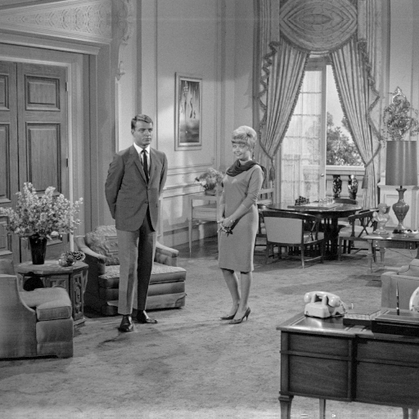
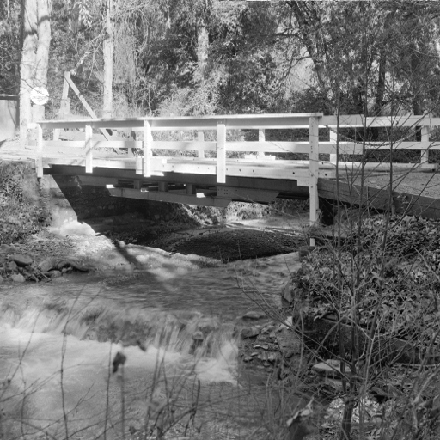
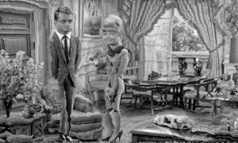
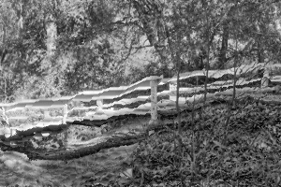
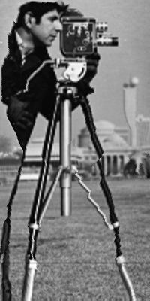
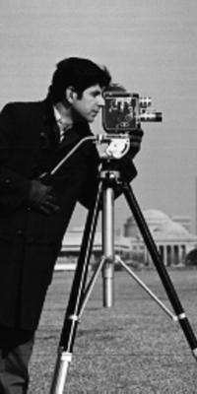
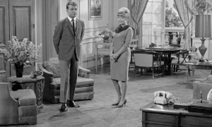
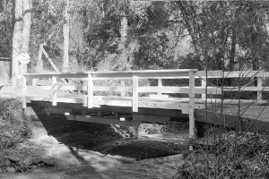
Improved Results
Seam carving
Seam carving
Histogram
Histogram
Seam carving
Histogram

Slide 15
Conclusions
The seam carving method works great for small changes to the size of the image
When the output aspect ratio is very different from the input, the histogram-based approach works better to avoid distortions to the objects of the image
Currently, the user must specify which method to use, but further work would be to automatically determine the optimal method to resize the image.

Slide 16
References
Avidan, Shai, and Ariel Shamir. "Seam carving for content-aware image resizing." ACM Transactions on graphics (TOG). Vol. 26. No. 3. ACM, 2007.

Slide 17


